Slide 1
DeepGarment
3D Garment Shape Estimation from a Single Image
R.Danerek, E.Dibra, C.Oztireli, R.Ziegler, M.Gross
ETH Zurich, Vizrt Switzerland

Slide 2
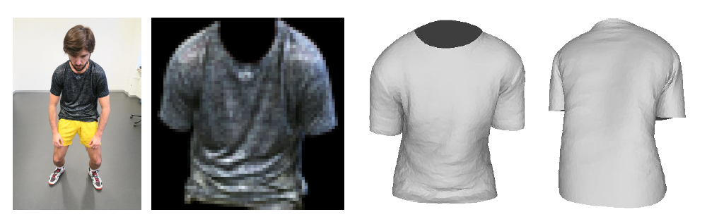
Problem:
Recover the 3D shape of a garment from a single image

Slide 3
Related Work
Structure-from-motion-based techniques
modify and extend the standard SfM (Structure from motion) setup to estimate the shape of the garment
Rely on special markers depicted on the garment
Multi-view camera setup

Slide 4
Related Work
Shape-from-shading-based techniques
model garment from a single image, utilizing statistical human body models and having the user outline the silhouette of the garment and set the body pose
User-specified garment outlines
assuming symmetry in order to model the garment from the back as well
run-time in order of minutes
inability to handle self occlusions of the character
Notes:
Shading of the image to recovery the depth map for the initial garment, and reintroduce the details from the initial garment to the updated garment shape

Slide 5
Related Work
Data-driven techniques
focus on estimating the naked human body shape from images and model clothing as an “offset” from the naked body shape
Notes:
SCAPE (Shape Completion and Animation for People)
DRAPE (DRessing Any PErson)

Slide 6
Related Work
Estimate 3D garment shape from a single image
assume depth is know
restricted mannequin poses and given cloth panels
considerable manual interaction
map wrinkle patterns and segmented garments to cloth parameters and materials through fitting
Notes:
SCAPE (Shape Completion and Animation for People)
DRAPE(DRessing Any PErson)

Slide 7
DeepGarment
Data-driven technique leveraging deep learning technique
Goal: obtain the correct global 3D shape, possibly with plausible high-frequency deformations (such as wrinkles and folds)
Data Generation
3D Garment Shape Reconstruction with CNN
Interpenetration Handling
Notes:
Our goal is to obtain the correct global 3D shape, possibly with plausible high-frequency deformations (such as wrinkles and folds), ready to be used in applications such as virtual avatars.

Slide 8
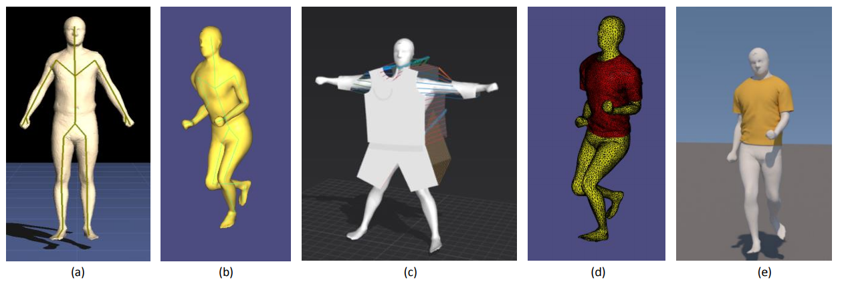
Data Generation
Database: pairs of renderings and the corresponding 3D garment shapes

Slide 9
Data Generation
Human Model Creation : picked 10 meshes generated by a statistical human shape model
Human Model Animation: 3D skeletons extracted from motion capture dataset. Attach the skeletons to human shapes with an automatic method that computes skinning weights. Animate by applying Dual Quaternion Skinning
Garment Design: Marvelous Designer
Garment Simulation: ARCSim physically based simulation
Rendering
Notes:
Picked 10 meshes, from a dataset of 1500 male meshes, generated by a statistical human shape model, covering major variations in body types
For animation we utilize varying motions such as walking, running, jumping, turning, dancing, and boxing sequences, represented as 3D skeletons and extracted from an available motion capture dataset, adding up to 20 minutes of motions.
We attach the skeletons to the human shapes with an automatic method that computes skinning weights (a), by augmenting its implementation with our motion capture skeleton. Each motion pose is then represented as a transformation relative to a T-pose, scaled to the size of the corresponding auto-rigged bones and mesh.
The meshes are animated applying Dual Quaternion Skinning as in (b).
Garment Design: Marvelous Designer
Garment Simulation: ARCSim physically based simulation
we run our simulations at 30 FPS, which results in approximately 15000 shapes per character and per garment (with the resolution of 6500 vertices, and 12800 triangles
Rendering: Mitsuba
The garment material is set to be diffuse due to Lambertian assumptions and the color is randomly sampled
realistic sun-sky emitter varying its position
The camera pose is also varied to capture view-point changes

Slide 10
3D Garment Shape Reconstruction with CNN
Learn the deformation (simply represented as the vertex displacement) from a reference mesh (either a garment mesh or a body mesh, depending on the application) with respect to image observations using a CNN
Given an input image, the system masks the garment, and feeds it as an input to a specialized CNN, trained end-to-end to regress to 3D garment vertex deformations or offsets from a template mesh or human body

Slide 11
Mesh Deformation Representation
2 different representations for garment deformation
Both are based on the idea of vertex displacements, with different reference meshes
Garment-from-Garment Shape Representation: displacements from a reference garment mesh which is dressed on a character in a T-pose
Garment-from-Body Shape Representation: offset from a body mesh
Displacement of 3D coordinates
PCA analysis to reduce the dimension
Notes:
Depends on the intended application. The garment-from-garment shape representation does not guarantee that any estimated garment shape will fit the body mesh of our choice. Hence, if the intended application is to dress human meshes, we can use garment-from-body shape representatio

Slide 12
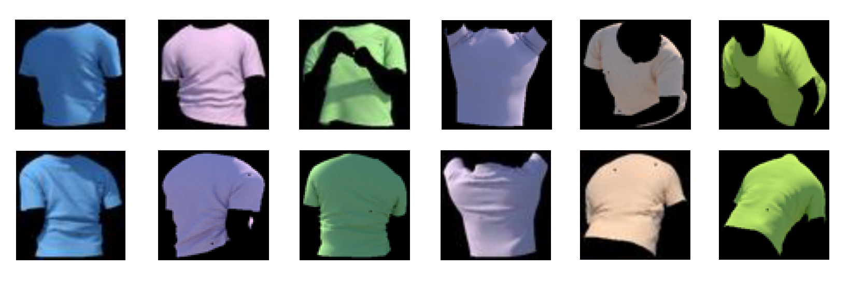
Segmentation
Segment out the garment from the background
An accurate segmentation is obtained by assuming a background model, utilizing Gaussian Mixture Models to learn a background model, and finally segmenting with graphcuts

Slide 13
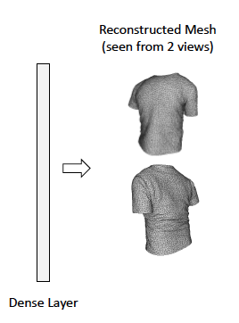
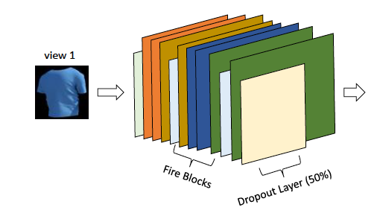
Single-View Architecture
Input images are masked and resized to 64x64 pixel
Notes:
Input channel: 64x64x3
Input the

Slide 14
Two-View Architecture
Utilize the information from the multi-view input to produce more accurate results
Combine information coming from multiple views at a later stage by separately training two similar CNN-s on each view, and then concatenating the outputs of the last convolutional layer of each CNN through a view-pooling layer that performs either a max or a concatenation operation
Notes:
simply concatenating the images along the channel dimension and then passing them through an architecture similar to the single-view one described above performs worse than the networks trained on single-view input only
One reason for this would be that including a complementary view at the early stages of the network, for the same amount of training data, might inflict noise in the system
has almost twice as many parameters and therefore doubles the training time and the memory needed

Slide 15
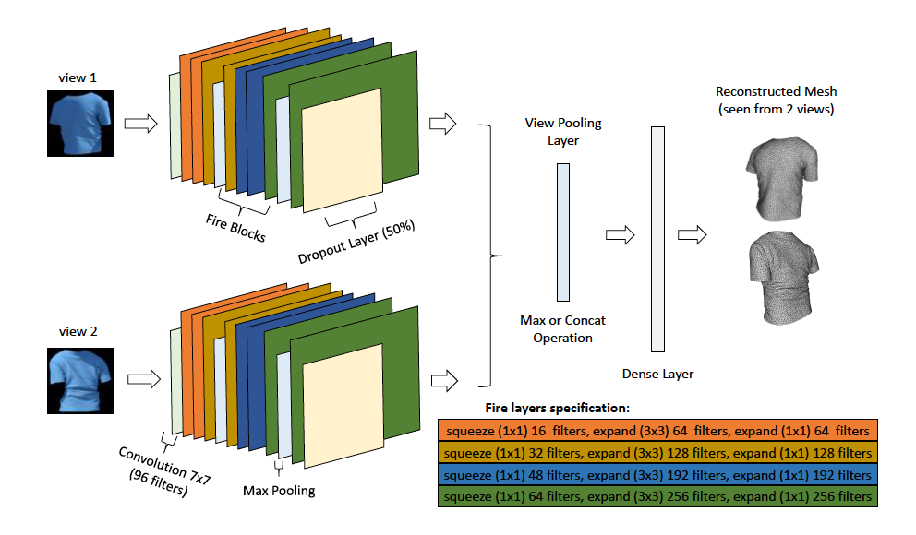
Two-View Architecture

Slide 16
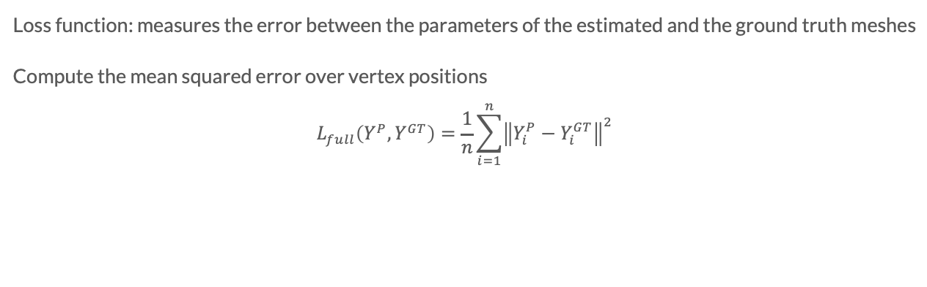
Loss Layer
Loss function: measures the error between the parameters of the estimated and the ground truth meshes
Compute the mean squared error over vertex positions
$$L_{full}\left(Y^{P},Y^{GT}\right)=\frac{1}{n}\sum_{i=1}^{n}{{\left\|Y_{i}^{P}−Y_{i}^{GT}\right\|}^{2}}$$

Slide 17
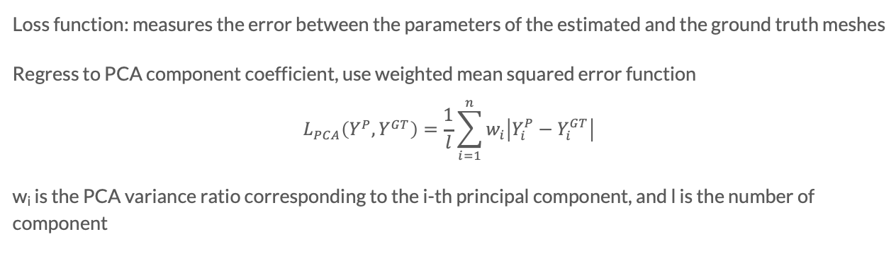
Loss Layer
Loss function: measures the error between the parameters of the estimated and the ground truth meshes
Regress to PCA component coefficient, use weighted mean squared error function
$$L_{PCA}\left(Y^{P},Y^{GT}\right)=\frac{1}{l}\sum_{i=1}^{n}{w_{i}\left|Y_{i}^{P}−Y_{i}^{GT}\right|}$$
w_{i} is the PCA variance ratio corresponding to the i-th principal component, and l is the number of component

Slide 18
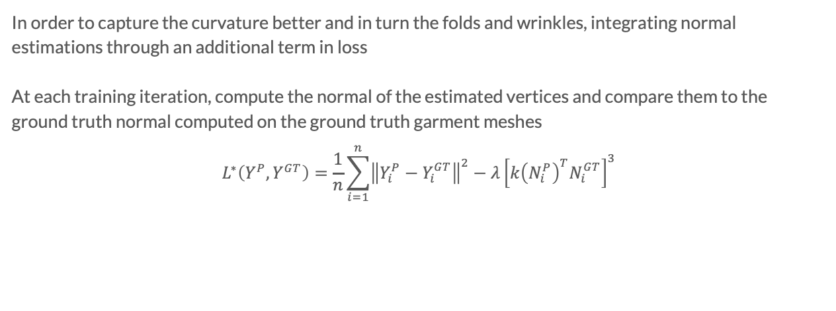
Loss Layer
In order to capture the curvature better and in turn the folds and wrinkles, integrating normal estimations through an additional term in loss
At each training iteration, compute the normal of the estimated vertices and compare them to the ground truth normal computed on the ground truth garment meshes
$$L^{∗}\left(Y^{P},Y^{GT}\right)=\frac{1}{n}\sum_{i=1}^{n}{{\left\|Y_{i}^{P}−Y_{i}^{GT}\right\|}^{2}}−λ{\left[k{\left(N_{i}^{P}\right)}^{T}N_{i}^{GT}\right]}^{3}$$
Notes:
ƛ is a weighting term set by the user that controls the influence of the normals as opposed to the vertex positions
k is a stretching term (set to 3) of the dot product, which when combined with the cubic exponential, gives more weight to the penalization for estimated normal that form a large angle with respect to the ground truth

Slide 19
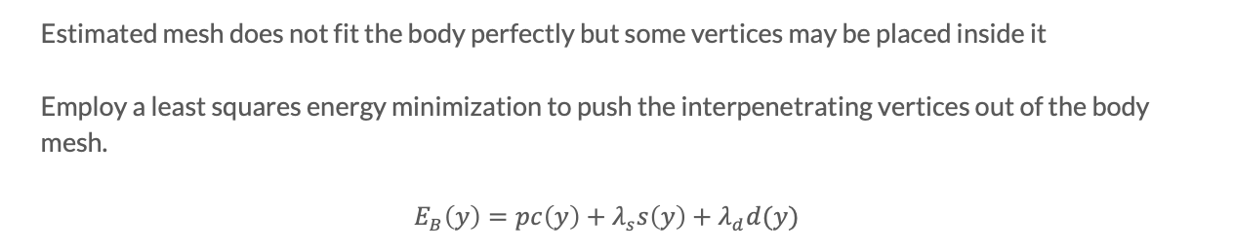
Interpenetration Handling
Estimated mesh does not fit the body perfectly but some vertices may be placed inside it
Employ a least squares energy minimization to push the interpenetrating vertices out of the body mesh.
$$E_{B}\left(y\right)=pc\left(y\right)+λ_{s}s\left(y\right)+λ_{d}d(y)$$
Notes:
especially in cases where the input pose or body shape is very different from the shapes and poses that we consider during our training stage.
iterate over the described process multiple times to get rid of the interpenetration entirely

Slide 20
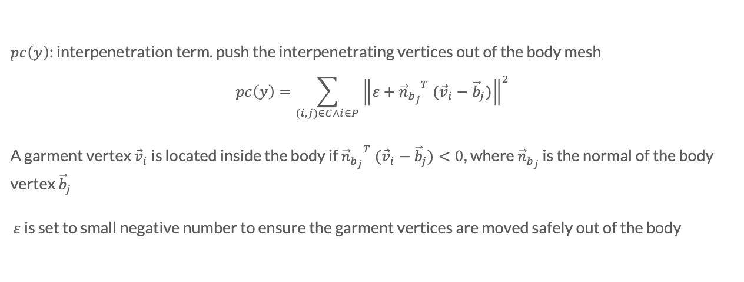
Interpenetration Handling
$pc\left(y\right)$: interpenetration term. push the interpenetrating vertices out of the body mesh
$$pc\left(y\right)=\sum_{(i,j)∈C∧i∈P}{{\left\|ε+{{\vec{n}}_{b_{j}}}^{T} ({\vec{v}}_{i}−{\vec{b}}_{j})\right\|}^{2}}$$
A garment vertex ${\vec{v}}_{i}$ is located inside the body if ${{\vec{n}}_{b_{j}}}^{T} ({\vec{v}}_{i}−{\vec{b}}_{j})<0$, where ${\vec{n}}_{b_{j}}$ is the normal of the body vertex ${\vec{b}}_{j}$
$ε$ is set to small negative number to ensure the garment vertices are moved safely out of the body
Notes:
This equation is underdetermined and has infinitely many solutions, therefore 2 additional terms are added to regularize the system

Slide 21
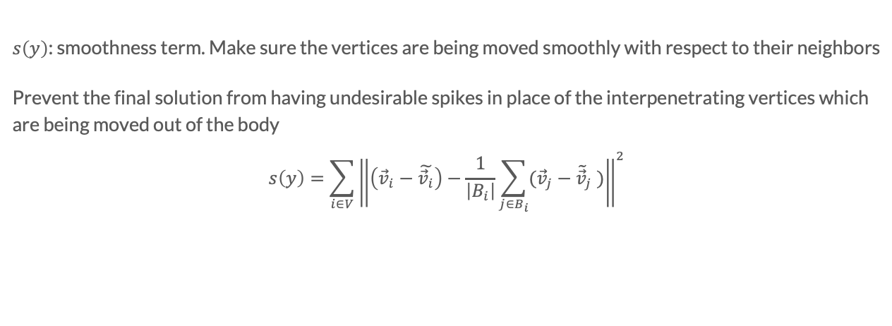
Interpenetration Handling
$s\left(y\right)$: smoothness term. Make sure the vertices are being moved smoothly with respect to their neighbors
Prevent the final solution from having undesirable spikes in place of the interpenetrating vertices which are being moved out of the body
$$s\left(y\right)=\sum_{i∈V}{{\left\|\left({\vec{v}}_{i}−\tilde{{\vec{v}}_{i}}\right)−\frac{1}{\left|B_{i}\right|}\sum_{j∈B_{i}}{({\vec{v}}_{j}−{\tilde{\vec{v}}}_{j} )}\right\|}^{2}}$$
Notes:
v~ the current position of vertex i, V the set of vertices and B_{i} the list of neighboring vertices of vertex i

Slide 22
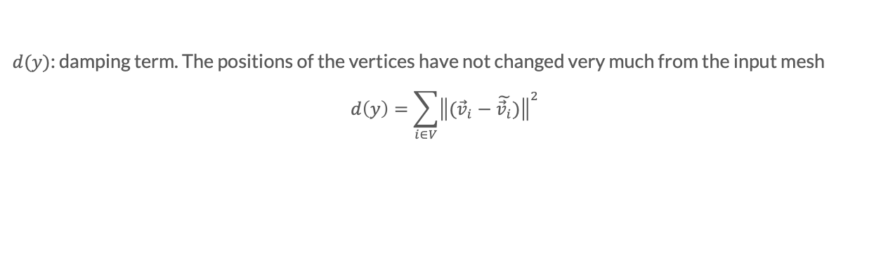
Interpenetration Handling
$d(y)$: damping term. The positions of the vertices have not changed very much from the input mesh
$$d\left(y\right)=\sum_{i∈V}{{\left\|({\vec{v}}_{i}−\tilde{{\vec{v}}_{i}})\right\|}^{2}}$$

Slide 23
Results
100000 T-shirt meshes on 7 male bodies of various shapes creating a geometry dataset
15000 dress meshes
Dataset consists of purely synthetic images, hence the training has never seen a real image, but is still able to capture plausible low-frequency deformations on real data
Notes:
we evaluate it on synthetic and real images and videos, both qualitatively and quantitatively.

Slide 24
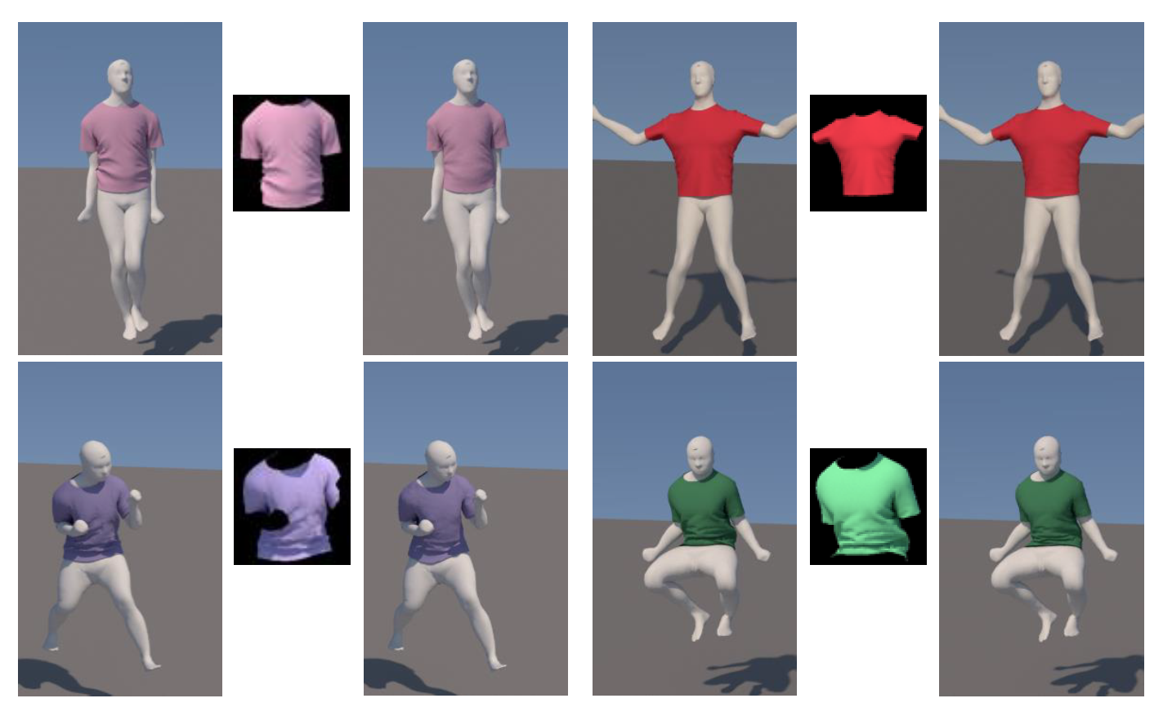
Results

Slide 25
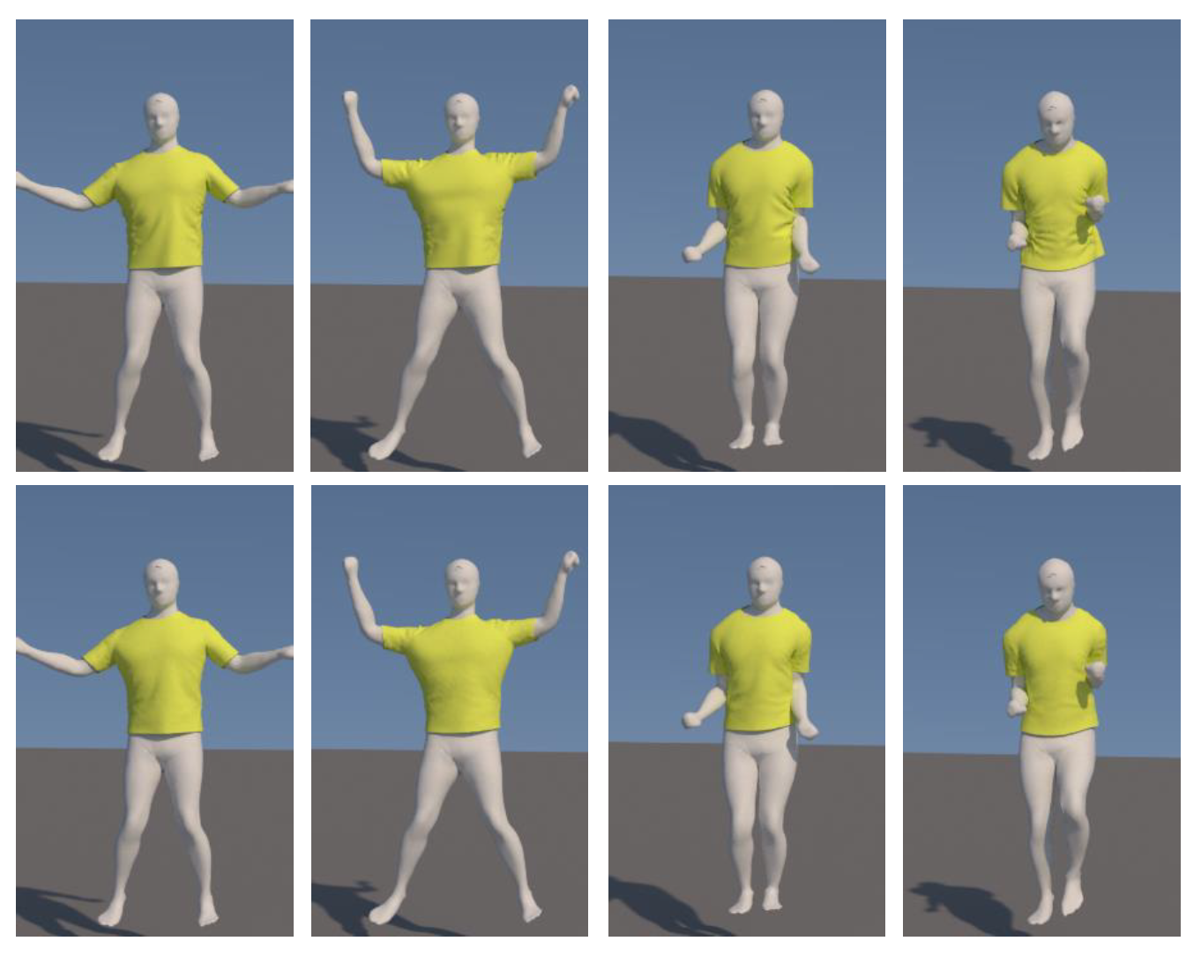
Results

Slide 26
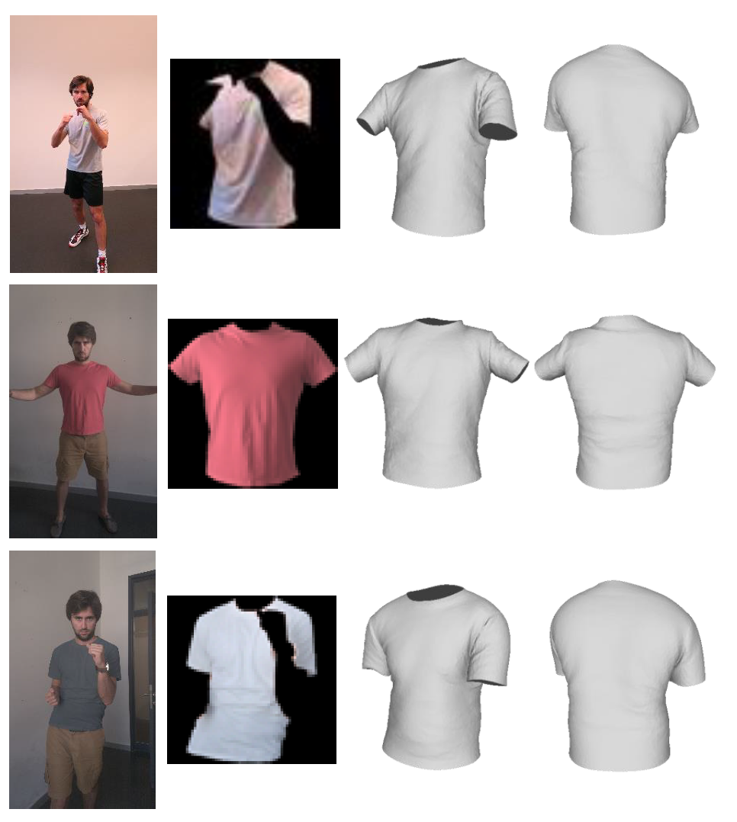
Results

Slide 27
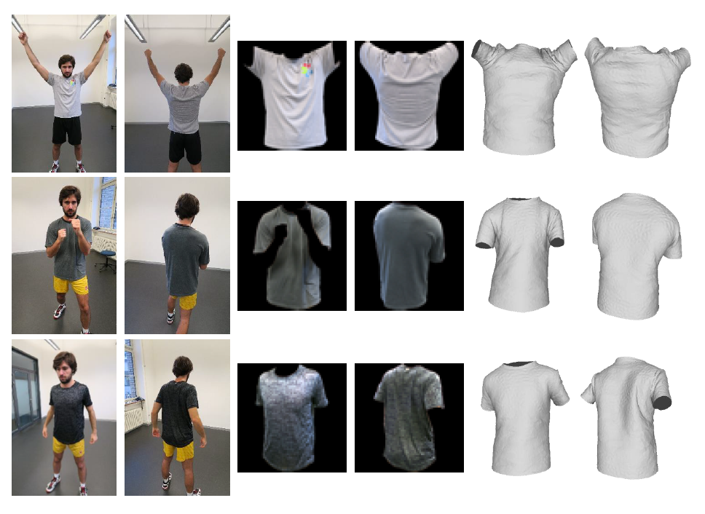
Results

Slide 28
Conclusions
“Garment-from-Body” formulation is better for dressing characters
“Garment-from-Garment” is more suitable for reconstructing the garment only
The multi-view architectures achieve superior performance in comparison to the single view models on both datasets

Slide 29
Limitations
Introduce the artifacts during data generation
Small input images prevent the method from capturing some of the wrinkles
Need to train a new model for every new clothing type since the reference garment mesh may vary

Slide 30
Contributions
An end-to-end 3D garment shape estimation algorithm. The algorithm automatically extracts 3D shape from a single image captured with an uncontrolled setup that depicts a dynamic state of a garment at interactive rates
A regressor based on convolutional neural networks (CNN-s) combined with statistical priors and a specialized loss function for garment shape estimation

Slide 31
Thank You!

